Slide 1
My body

Slide 2
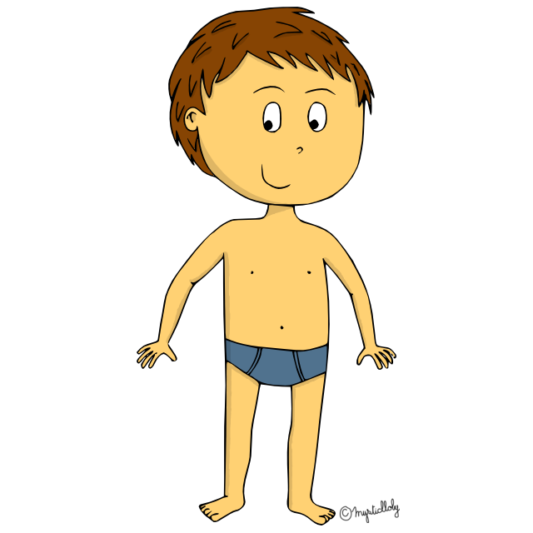
head
shoulders
knees
toes

Slide 3
eyes
nose
ear
mouth

Slide 4
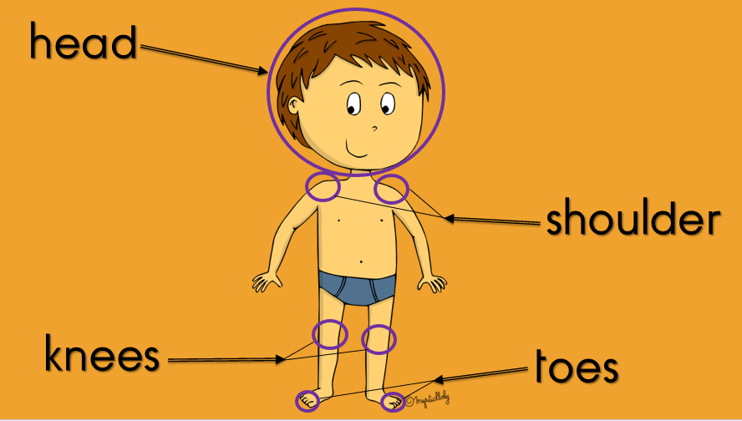
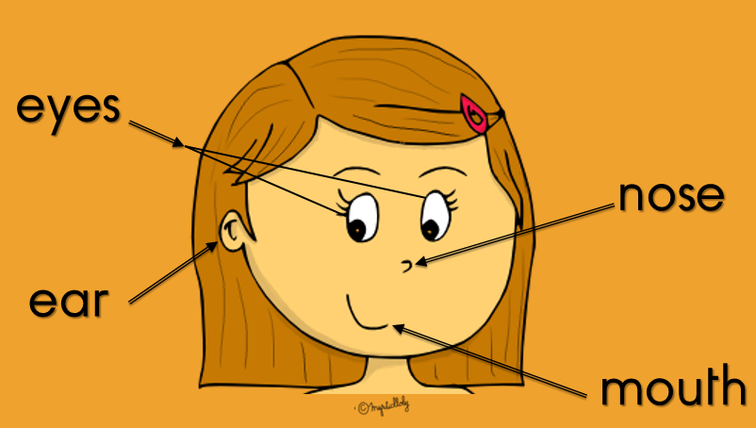
my body

Slide 5
Head and shoulders

Slide 8
Head and shoulders

